Slide 1
SUMMARY OF SALES BASED ON HISTORICAL DATA OF XYZ COMPANY
TABLE OF CONTENT
DASHBOARD OVERVIEW
INSIGHT BASED ON SUM OF REVENUE FOR XYZ COMPANY
INSIGHT BASED ON SUM OF REVENUE FOR XYZ COMPANY IN 2014
INSIGHT BASED ON SUM OF REVENUE FOR XYZ COMPANY IN 2015
RECOMMENDATION/CONCULSION BASED ON ANALYSIS

Slide 2
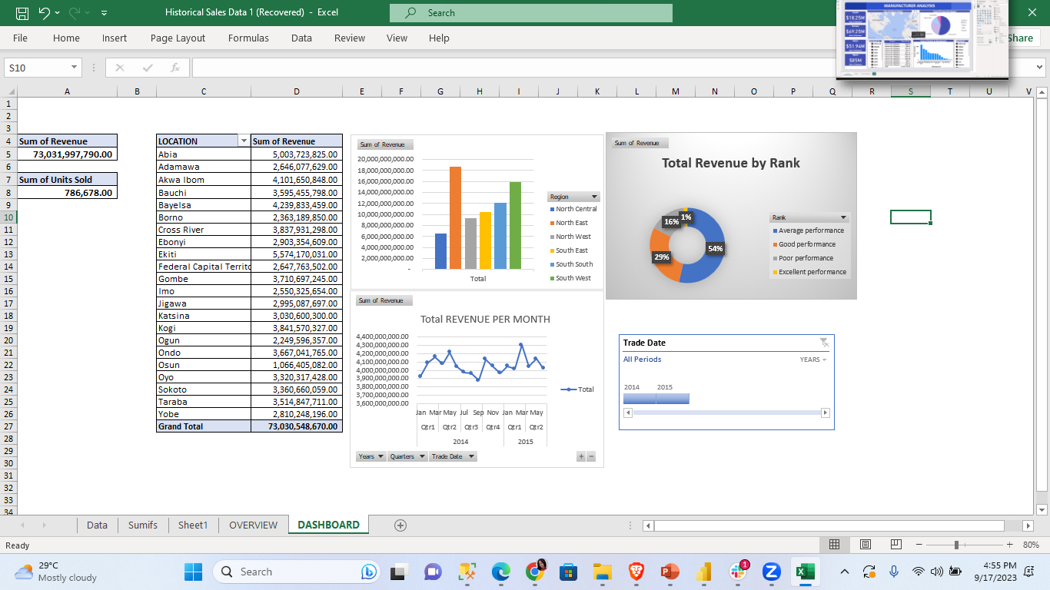
DASHBOARD OVERVIEW

Slide 3

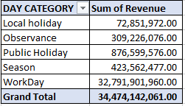
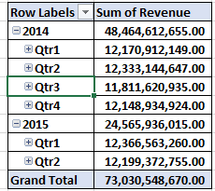
INSIGHT BASED ON SUM OF REVENUE FOR XYZ COMPANY
SUM OF REVENUE WAS 73,031,997,790
SUM OF UNIT SOLD 786,678
THE HIGHEST REVENUE WAS GENERATED DURING WORKDAY AND LEAST WAS DURING SEASON
HIGHEST REVENUE BY LOCATION WAS ABIA STATE WHILE OSUN WAS THE LOWEST
IN 2014 THE SUM OF THE 1ST 2 QUARTERS WAS 24,504,056,796

Slide 4

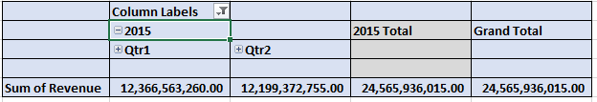
INSIGHT BASED ON SUM OF REVENUE FOR XYZ COMPANY IN 2015
SUM OF REVENUE WAS 24,567,385,135.00
SUM OF UNIT SOLD 269,665.00
NORTH EAST HAVING THE HIGHEST REVENUE WHILE NORTH CENTRAL HAVING THE LOWEST REVENUE
HIGHEST REVENUE BY LOCATION WAS ABIA STATE WHILE OSUN WAS THE LOWEST
IN 2015 SALES WAS ONLY RECORDED FOR ONLY THE 1ST and 2nd QUARTERS,HAVING A SUM OF 24,568,385,135

Slide 5
RECOMMENDATION
SALES SENSITIZATION IN TERM OF DAY CATEGORY
ADVERTISEMENT
SALES SHOULD BE TARGETED ALL YEAR ROUND

Slide 6
CONCULSION BASED ON ANALYSIS
IRRESPECTIVE OF THE FACT THAT THE TOTAL REVENUE AND UNIT SOLD IN 2014 IS SHOWING THAT ITS HIGHER THAN THAT OF 2015 BUT WHEN TOTAL REVENUE AND UNIT SOLD IS CONSIDERED IN RESPECT TO TRADE DATE (1ST AND 2ND QUARTER) REVERSE IS THE CASE.
CONSIDERING THE FACT THAT SALES WAS ONLY RECORED IN 2015 FOR ONLY 1ST AND 2ND QUARTER , WHEN COMPARED TO THAT OF 1ST AND 2ND QUARTER OF 2014;
IN TERMS OF REVENUE THERE WAS INCREASE IN 2015 BY 64,328,339
IN TERMS OF UNIT SOLD THERE WAS INCREASE IN 2015 BY 16,560.

Slide 7


